Slide 1
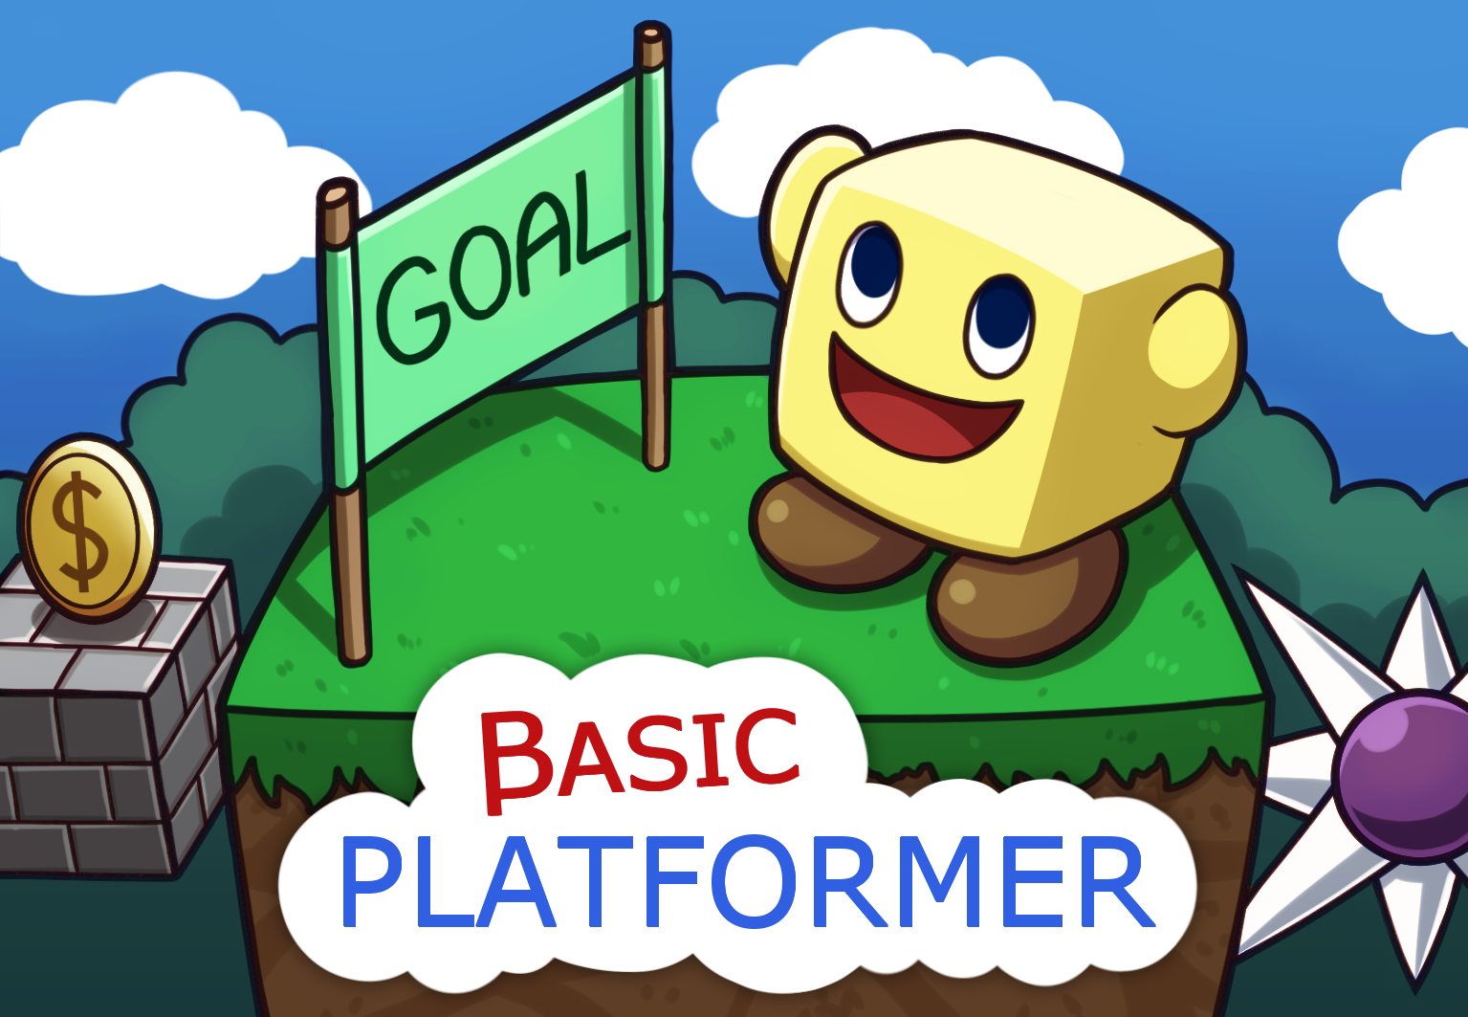

BASIC PLATFORMER
INSTRUCTION MANUAL
32-BIT VIRTUAL CONSOLE

Slide 3

Please read this instruction manual carefully before using your Vircon32 console or your game cartridge. Then keep this manual for any future consultations you may have about playing this game.
This seal guarantees that the Vircon32 community has tested this product and that it fulfills the needed requirements to ensure a reliable gaming experience.
Always look for this seal on your products to ensure a complete compatibility with your Vircon32 console and accessories.
EPILEPSY WARNING
READ BEFORE USING YOUR VIRCON32 GAME
A very small proportion of the population may experience epileptic seizures when viewing certain patterns of flashing lights that are common in our everyday environments. These people may experience seizures while watching some video images or playing certain videogames.
Players who have never had seizures previously might still have an as of yet undetected epilectic condition. Consult your physician before playing videogames if you have an epilectic condition, or if you experience any ot these symptoms while playing videogames: altered vision, muscle twitching, involuntary movements, loss of awareness, mental confusion and/or convulsions.
1

Slide 4

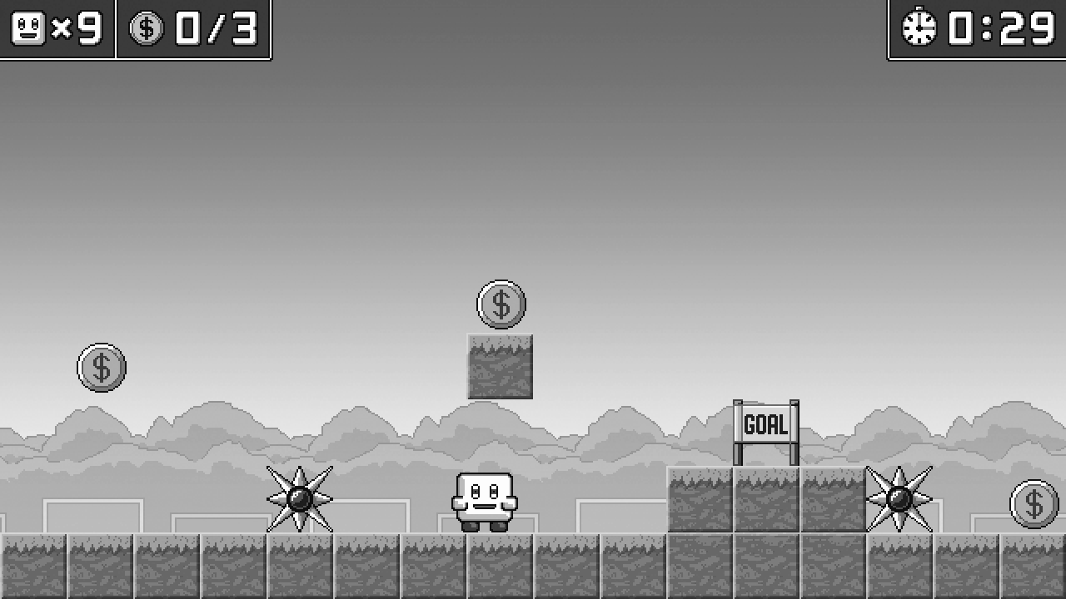
Thank you for choosing Basic Platformer! This manual will teach you everything you need to know to play this game.
The game screen
Here are the basic game elements you will see when playing:
Level coins
(collected / total)
Remaining lives
Remaining time
Coins to collect
You !
Level goal
2

Slide 5
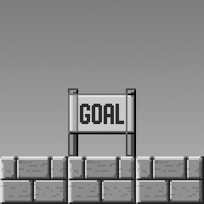
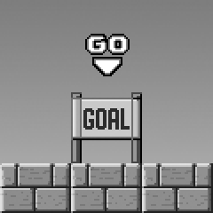
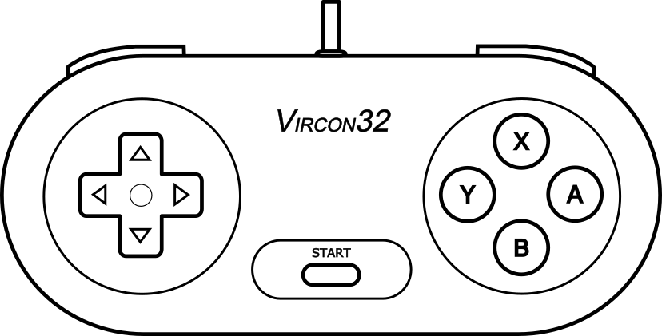
How to play the game
The objective in this game is to clear every level. There are a total of 3 worlds with 10 levels each. To achieve this your character is given 9 lives when starting each world.
To clear a level you must first collect every coin in that level and then reach the level goal. All of this has to be done without dying, and before the allowed time runs out.
The level goal becomes enabled when you collect the last coin. This is shown in the game when a “GO” sign appears:
Game controls
Basic Platformer is a single player game and it only uses gamepad 1. The controls for gameplay are the following:
Move
left / right
Pause / resume
Jump
3

Slide 6


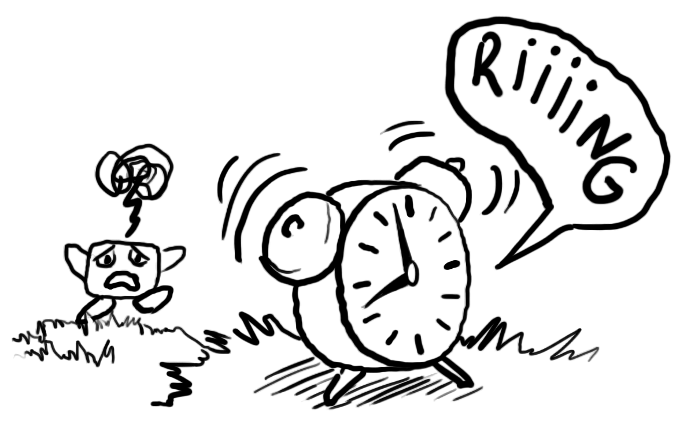
Basic game elements
Coins
You will have to collect all of these. Every level has a different number
of coins, so be sure to find them all!
The goal
After collecting all coins you need to find the level goal and reach it. Easier said than done…
The clock
Watch out for the allowed time for each level! An alarm will warn you when time is about to run out.
4

Slide 7
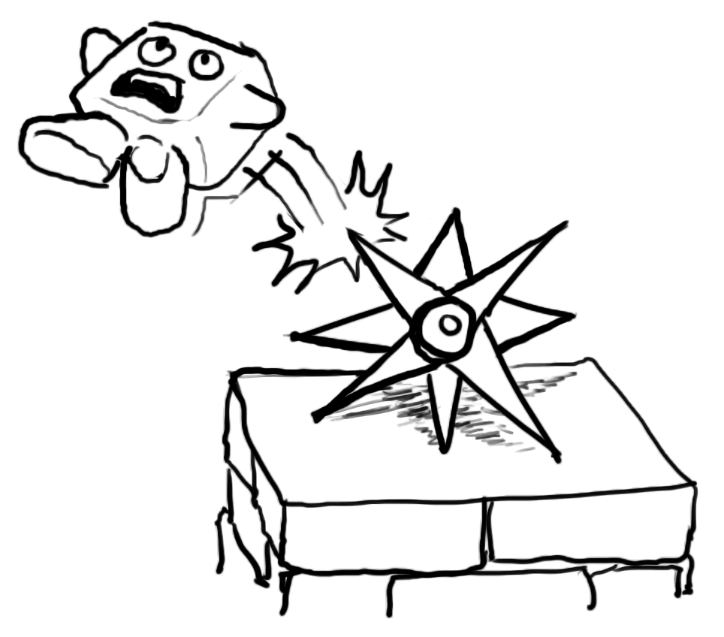
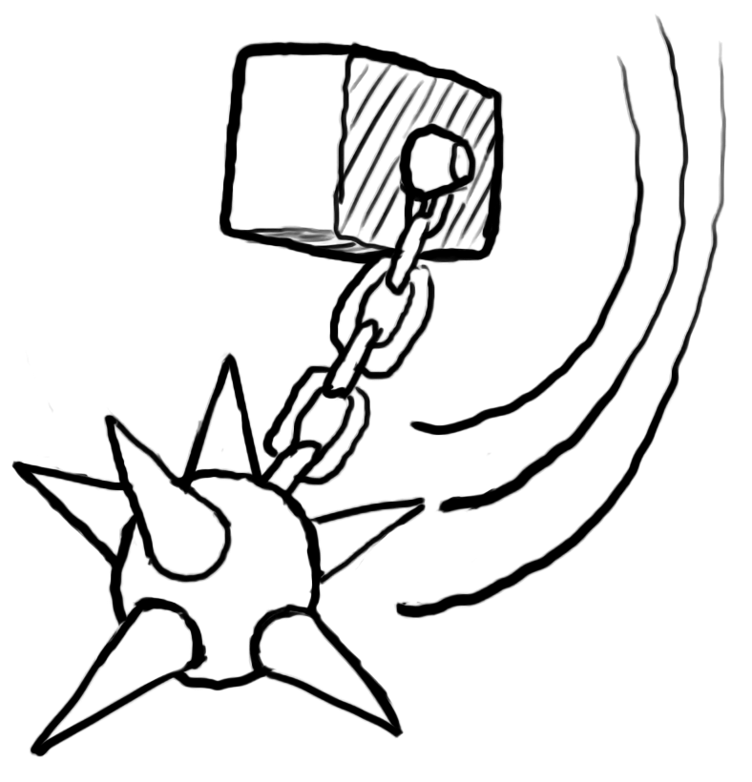
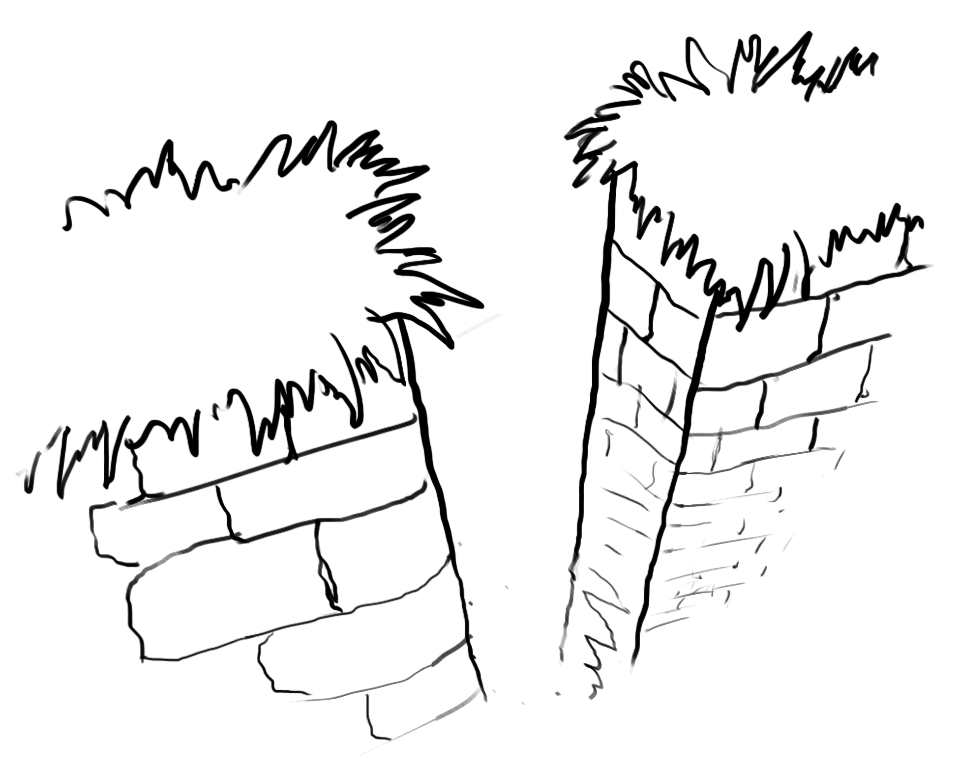
The dangers on the way
Spikes
They are the first hazard you will find, and are often found in groups. You will have to be careful with your jumps to avoid them.
Morning stars
If you thought that regular spikes were dangerous, then think again when you find these rotating spikes!
Bottomless pits
One of the most common elements that can kill you is simply falling into a place where no ground exists. Death is assured!
5

Slide 8
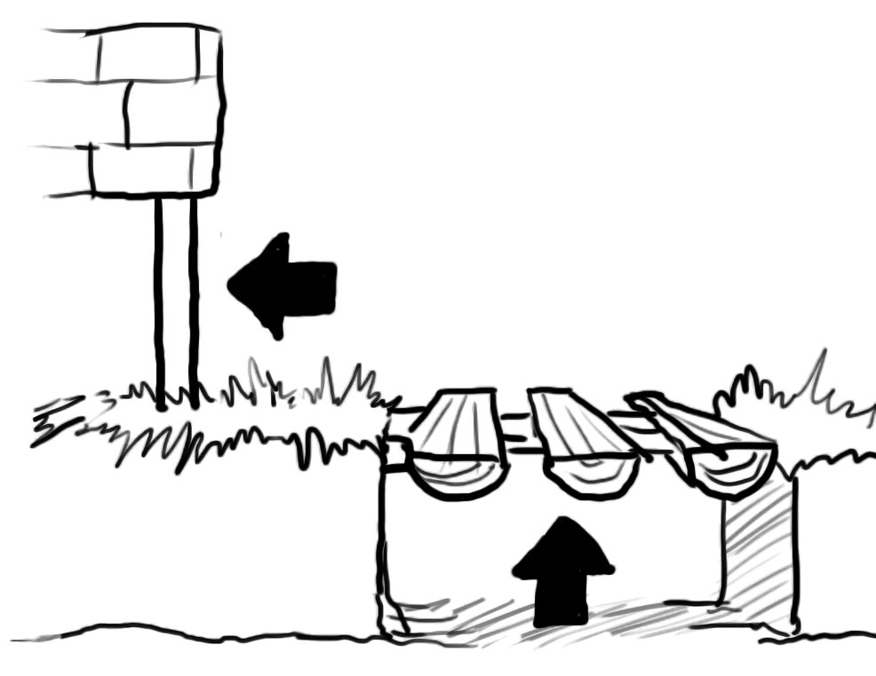
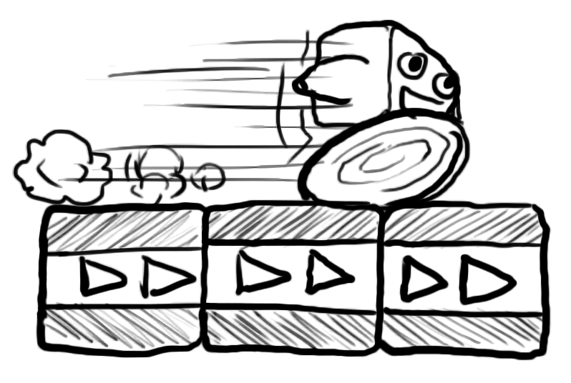
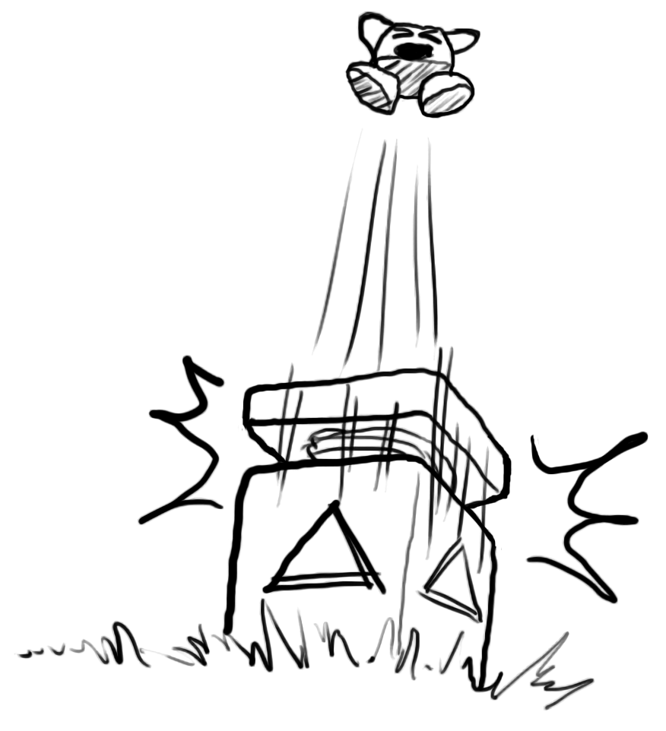
Moving through the levels
One-ways
There are platforms and doors that will only allow you to go through them in one direction! No going back for you.
Conveyors
These blocks propel you as shown by their arrows. That will also affect your jumps.
Springs
As soon as your feet touch the top of these blocks, a spring will release and boost you high into the sky!
6

Slide 9
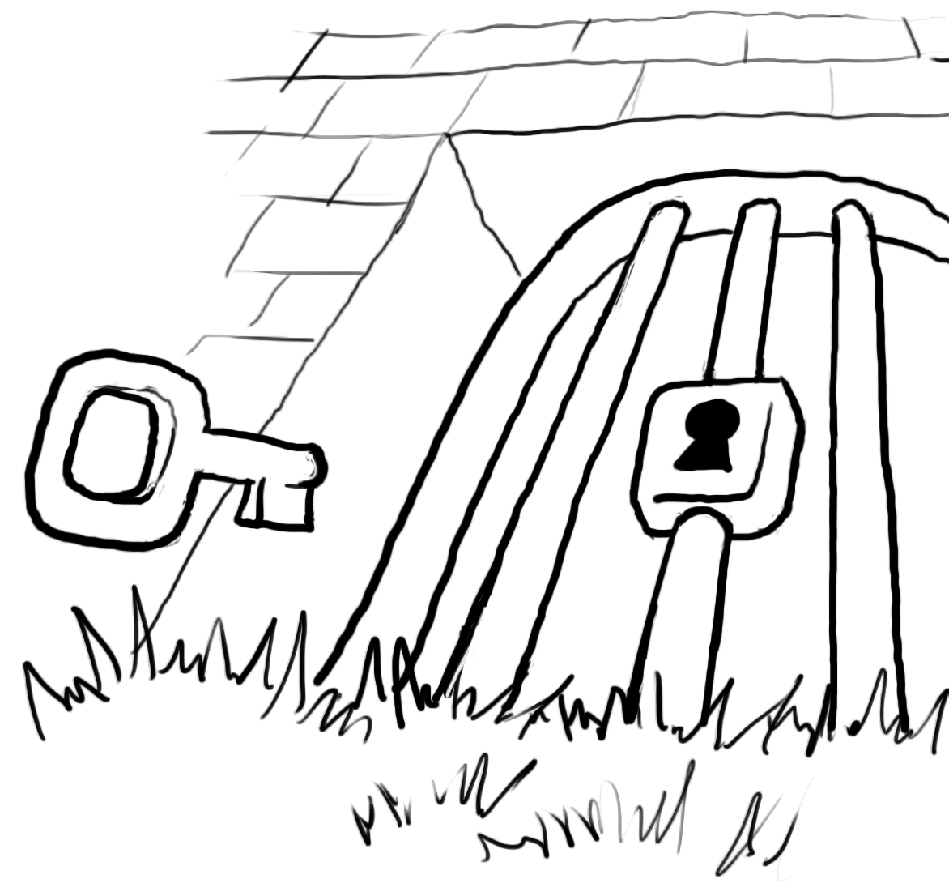
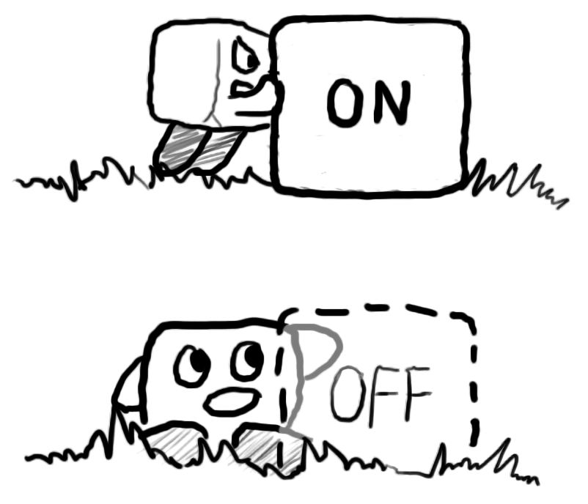
Puzzle elements
Doors
and keys
To go through these locked doors you will need to find a key to open them.
You can carry multiple keys at the same time.
On-Off blocks
These blocks go through a cycle, turning on and off at regular intervals.
When they are off you can go through them!
7

Slide 10
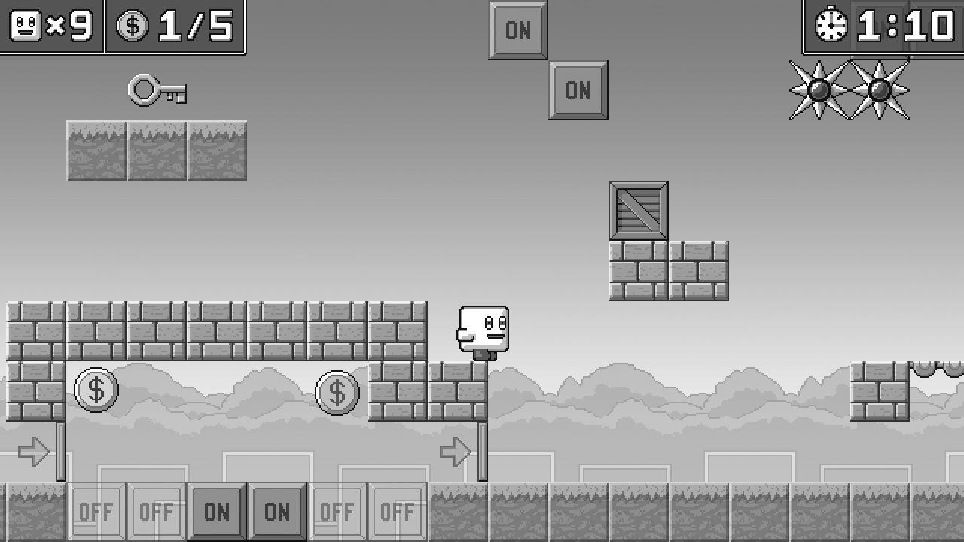
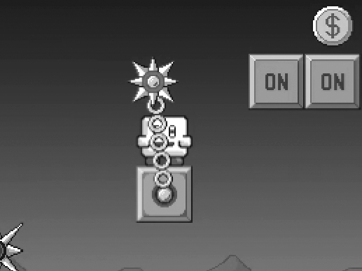
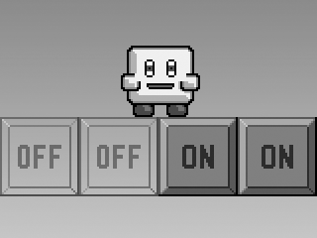
More advanced strategies
Level routing
Most levels are non linear, and you can find different paths to clear the level. Some paths are faster, others easier… do not be afraid to experiment.
Safe spots
If you are clever, you can carefully observe some of the obstacles and find places where you are never in danger.
8

Slide 12

@ 2022 CARRA
PRINTED IN MADRID, SPAIN
THIS INSTRUCTION MANUAL IS PART OF THE GAME ‘BASIC PLATFORMER’
AND SHOULD BE DISTRIBUTED ALONG WITH THE GAME PACKAGE.

